Slide 1
Final Presentation
Group QuantumBlack
May 05 2022
Notes:
Michael: 1-8
Thee: 9-14
Jim: 15 - 21
Yujie: 22 - 28

Slide 2
Table of contents
Problem Statement and Project Goals
Motivation
Related Work and Recent Progress
Available Data
Sampling and Splitting
Pre-Processing
Modeling Approach and Trajectory
Results

Slide 3
Problem Statement
We aim to create a generalized model for predicting drought by applying a wider breathe of modeling techniques to provide better aid and preparation to regions before the onset of drought.
Notes:
Current drought predictions are about as accurate as weather forecasts, with accuracy only up to 2-3 weeks.

Slide 4
Project Goals
Review of methods for long-term drought prediction in the continental U.S (CONUS) based on a number of climatrophic data sources
Analyze multiple forms of models for prediction across climate regions of the CONUS
Generate 2+ month forecasts of drought probability over the variety of climate regions in the CONUS
Notes:
We split our problem statement into 3 main goals:
A review of current methods
An analysis of models
A generation of a forecasting model

Slide 5
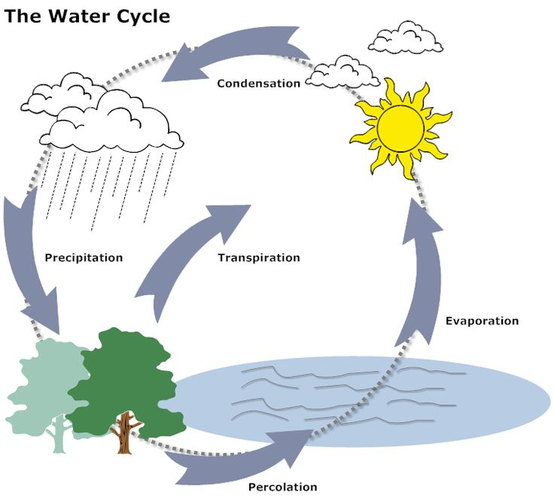
2. Motivation
Droughts have economical, environmental, and human costs caused by water’s importance in natural cycles and our reliance on their products by improving prediction we can better prepare regions for drought
Long-term rather than short-term regional drought prediction and generalized rather than localized forecasting
Notes:
Why do we care about drought?
Droughts impact the wider environment as well as humanity. Water is involved in every aspect of life from the obvious survival to the wider economy and society we have created.
Longer term prediction across a more generalized area would help direct funding, supplies, and mitigation efforts towards places that need it most.

Slide 6
3. Relevant knowledge & Literature review
Difficulties with drought in general: Complex causal mechanisms and ambiguous signals
Ault (Science, 2020), On the essentials of drought in a changing climate
Short term drought prediction: 2- and 4-week USDM forecasting
Lorenz et al. (American Meteorological Society, 2017), Predicting the U.S. Drought Monitor Using Precipitation, Soil Moisture, and Evapotranspiration Anomalies. Part II: Intraseasonal Drought Intensification Forecasts
Hyper-localized prediction: Prediction in small localized regions
Zhang et al. (Science of The Total Environment, 2019), Meteorological drought forecasting based on a statistical model with machine learning techniques in Shaanxi province, China
Notes:
Through our review of work in the larger field of drought prediction we have discovered 3 larger points:
Droughts are complicated and complex - the causal mechanisms for drought are indirect and droughts can occur in a variety of time frames. Unlike other natural disasters, droughts occur for regionalized reasons.
For this reason prior work in the field has focused on short term forecasting and hyper-localized predicting.

Slide 7
3. Relevant knowledge & Literature review
Recent progress in predicting drought: Introduction of ML and Deep Learning with greater access to data
Dikshit et al. (Applied Soft Computing, 2022), Artificial neural networks in drought prediction in the 21st century–A scientometric analysis
Poornima and Pushpalatha (Springer Nature: Soft Computing, 2019) Drought prediction based on SPI and SPEI with varying timescales using LSTM recurrent neural network
Hao (Review of Geophysics, 2018) Seasonal Drought Prediction: Advances, Challenges, and Future Prospects
Notes:
There has been recent progress made in drought prediction by the introduction of deep learning to the field as well as the concept of persistence.
Persistence, if there is drought one season will there coontinue to be

Slide 8
4. Available Data
Name | Record Date | Feature | Name | Category | Feature
USDM | 2012-2022 | Drought categories | Satellite | 2017-2022 | Change in vegetation area
SET | 2012-2022 | Evaporation, Runoff | NOAA | 2012-2022 | Temperature, Precipitation
SMAP | 2015-2022 | Soil moisture map
Note: Averaged by week by county
Notes:
Our prediction = county basis and predict a week / a couple of weeks into the future
Brunch of datasets that I found. We convert all of this into weekly data and on county level, most of the dataset starting from 2012.
Y = US Drought Monitoring. It is the drought severity index for each county
4 Xs
Spend some time talking abt satellite images

Slide 9
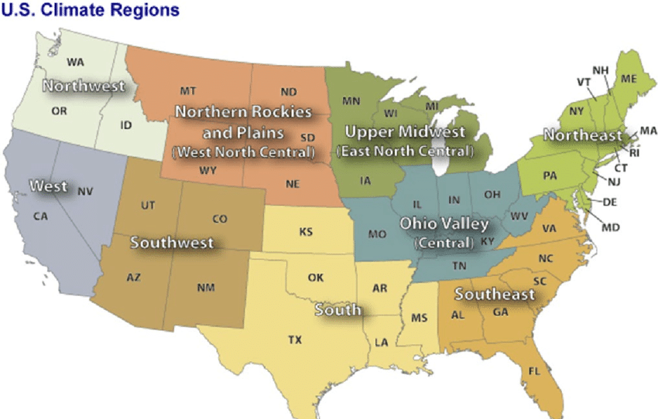
5. Sampling and Train-Test Split
Total of 3,143 counties across CONUS
9 climate regions, sample 50 per climate region
Our sample is representative and has no information leakage
Notes:
Now I will cover our methodology on how we sample dataset and split it into train and test sets.
We have county level data for around 3,143 counties across the Continental US. If we pull climate and satellite data from each county for 10 years (531 weeks), it will consume too much computational resource for pre-processing the data and fitting the model.
Therefore, we apply stratified sampling by sampling 50 counties from each climate region. We are convinced that our sample is representative of the CONUS and we test that counties in each region can be viewed as independent entries with no information leakage.

Slide 10
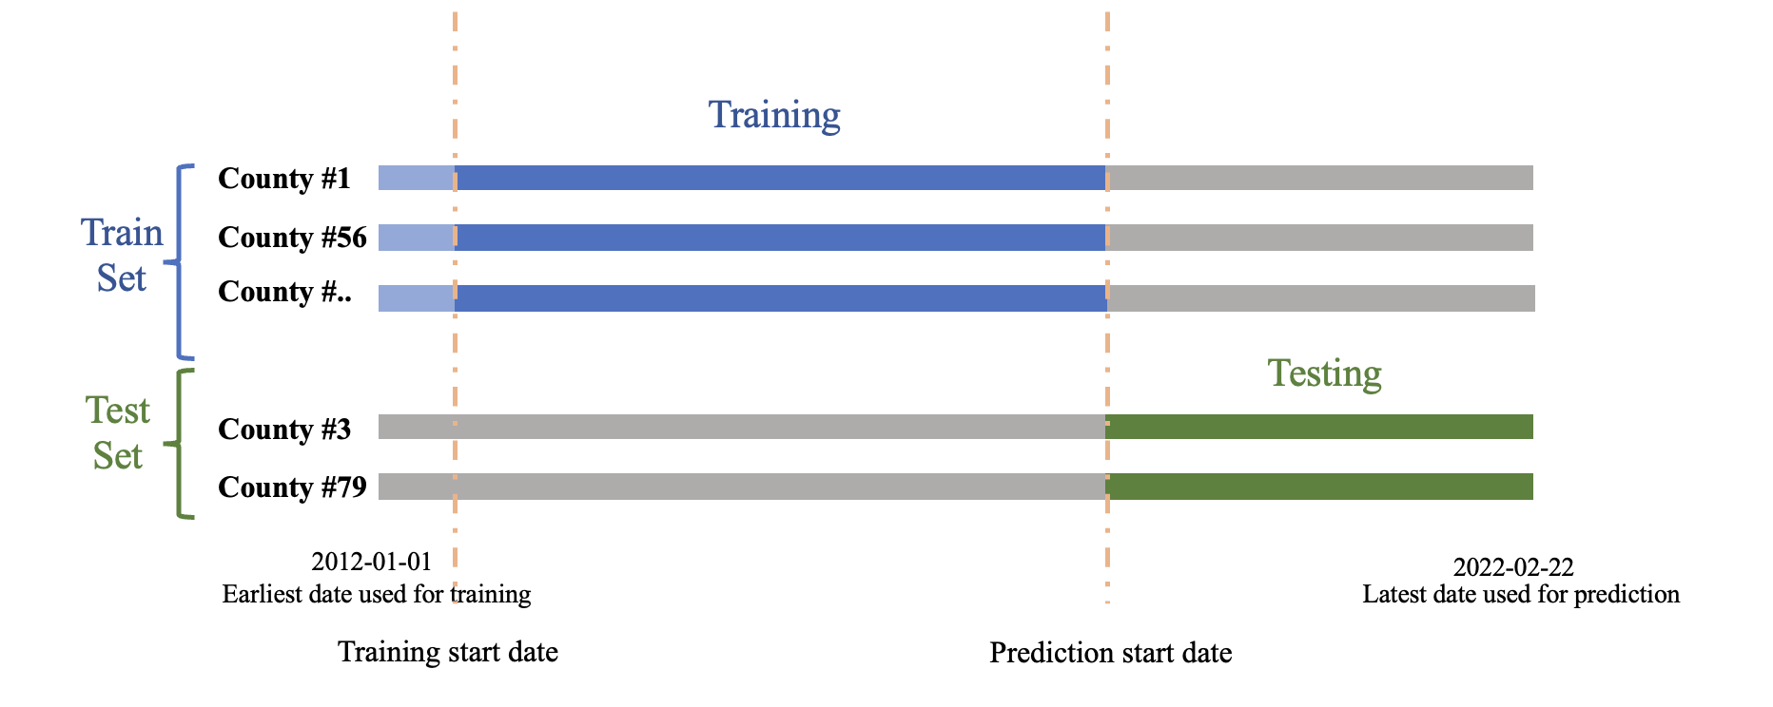
5. Sampling and Train-Test Split
Notes:
We split our dataset into train and test sets, as demonstrated in the slide, in order to test our model’s robustness across both time and space. To deal with cross-sectional data, we first take 80% of the counties to form our training set and stratify them by climate region. Then we subdivide training and testing periods by specifying the start date of training and the start date of prediction.

Slide 11
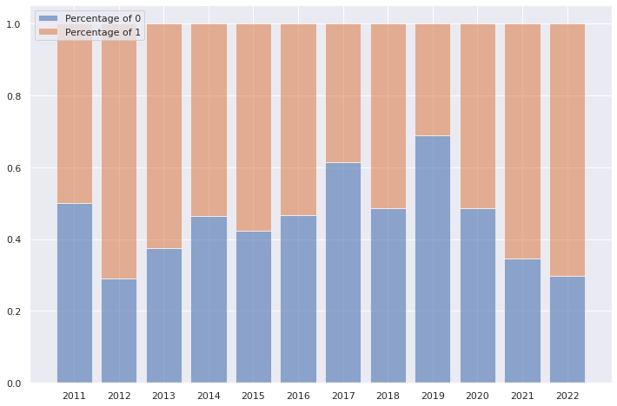
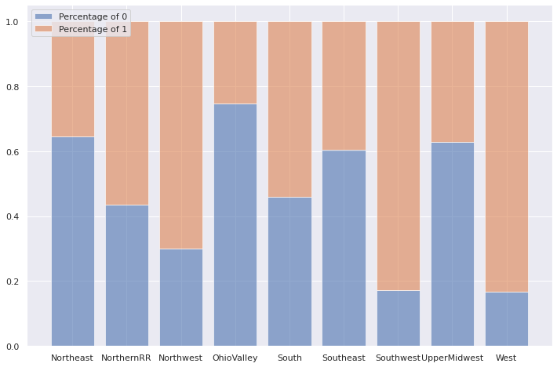
6. Pre-Processing: USDM (Response Variable)
USDM Drought Level (Response Variable):
For each week, USDM data specifies how many percentage of the area in each county belongs to which drought level (D0, D1, D2, D3, D4).
Response variable:
1 if all area has drought level < D0
0, otherwise
Notes:
There are some data preprocessing work that we need to do. Starting with our response variable y.
We frame our prediction task as a binary classification. Our response variable is 1 for a county if there is no area in the county with drought level greater than None according to the US Drought Monitoring metric. The response variable is 1 otherwise.
The ratio between response variable of 0 and 1 is distributed around 50:50 across time and space as shown in the figure. For each county, we aim to predict the response variable 4 to 26 weeks into the future.

Slide 12
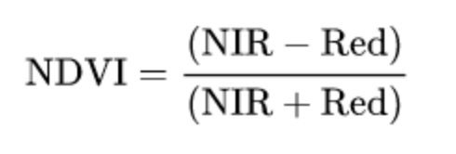
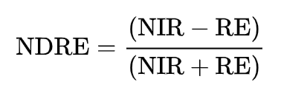
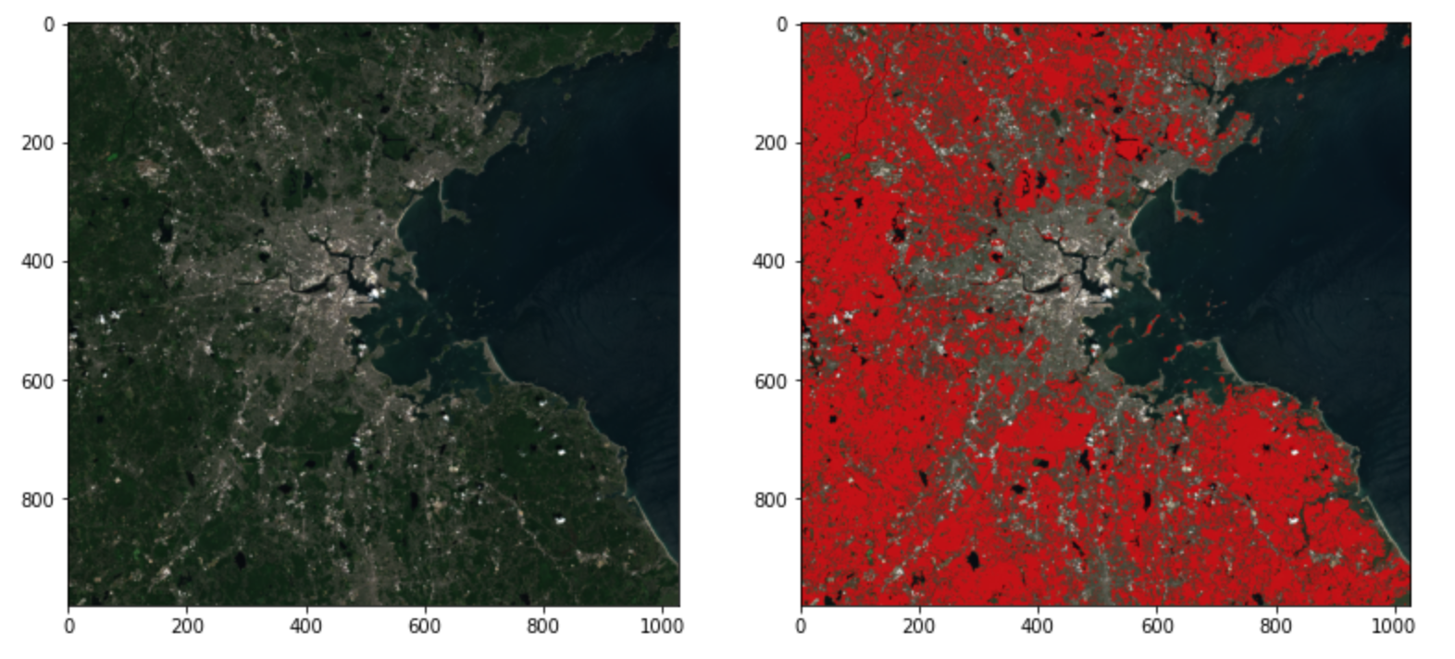
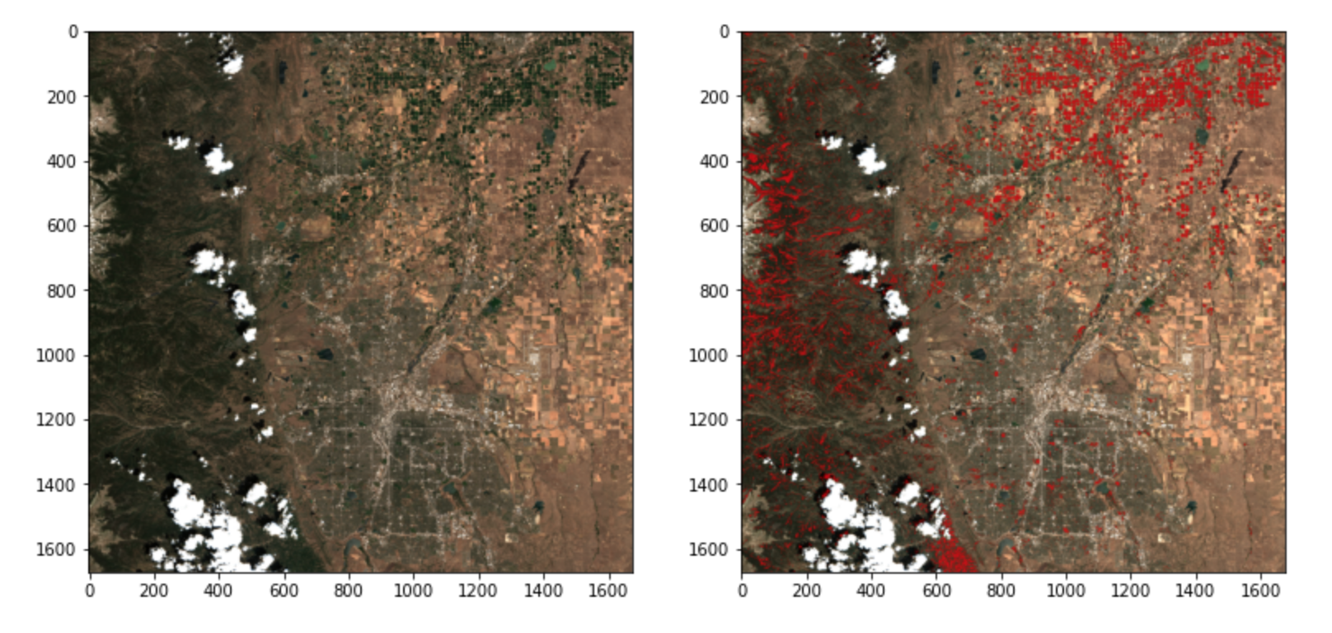
6. Pre-processing: Satellite Imagery (Predictor)
Normalized vegetation index (NDVI)
Normalized difference red edge index (NDRE)
Suffolk, MA 2020-07-15, Highlighted by Red when NDVI > 0.8
Broomfield, CO 2020-07-15, Highlighted by Red when NDRE > 0.65
Notes:
Now lets talk about how we preprocessing our predictor data. Starting with satellite image.
Two indices we will use to detect vegetation areas based on literatures and our partner domain experts in sat iamges
NDVI
NDRE
These indices are constructed to detect that
we can measure weekly changes in vegetaion area for each county over the past 5 years and use it as our predictors to predict drought risks

Slide 13
6. Pre-Processing: SMAP, NOAA, SET (Predictors)
SMAP, NOAA, SET (Predictors):
Imputation technique
Fill missing value by using the average of closest neighbors
Normalization and Standardization
Name | Record Date | Feature | Name | Category | Feature
SET | 2012-2022 | Evaporation, Runoff | NOAA | 2012-2022 | Temperature, Precipitation
SMAP | 2015-2022 | Soil moisture map
Notes:
Normalization to get 0 to 1.
or each feature, we impute missing entries using the mean value of that county; if the whole county is missing the data, we impute it with the global average.

Slide 14
7. Modeling Approach and Trajectory
First attempts
Predicting numerical USDM DSCI drought index using linear regression based models.
Meaningless prediction with high MSEs.
Worse than global average after 8 weeks.
Horizon | MSE | Horizon | MSE
1 week | 7540.58 | 5 weeks | 13278.54
2 weeks | 13712.84 | 6 weeks | -
3 weeks | 131.90 | 7 weeks | -
4 weeks | 760.25 | 8 weeks | 7072.54

Slide 15
7. Modeling Approach and Trajectory
Revisiting motivation & reexamine Y
Rethink two questions:
What for?
Drought aid and preparedness.
So we care more about the occurrence of drought, which itself is binary.
What is DSCI?
DSCI drought index is noisy. It is a weighted sum of classes:
DSCI = 1(D0) + 2(D1) + 3(D2) + 4(D3) + 5(D4)
Final revised modeling objective: predict the binary occurrence of drought
Notes:
The onset of drought itself is a binary event. It either happens or doesn’t
when 50% of a county's land area is in "Abnormally Dry" (which is not even considered as an onset of drought), its DSCI may be equivalent to another county with 10% of its land area in Exceptional Drought (which is the highest class for drought, which the county certainly needs drought aid)

Slide 16
7. Modeling Approach and Trajectory
Baseline: Logistic regression and Tree Based models
To facilitate comparison with previous literature, we must reproduce some published methodology frameworks on our dataset.
For baseline, we trained:
Logistic regression
Decision Tree
Random Forest
XGBoost
Results will be compared in the following section.

Slide 17
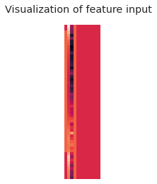
7. Modeling Approach and Trajectory
Neural Nets
Many-to-many: take in weeks of features, output weeks of predictions.
2D matrix input:
Neural nets take in 2D inputs of shape (n_weeks, n_features.
Vector output:
Neural nets predict (n_horizons)

Slide 18
7. Modeling Approach and Trajectory
Neural Nets: Recurrent NN
Unidirectional LSTM
First attempt is Long short term memory (LSTM) neural network.
Two part design:
embedding part(pink)
classification part(blue).
Reshape layer
CONV+Pooling+Dropout
CONV+Pooling+Dropout
Flatten
Dense+Normalization+Dropout
Dense+Normalization+Dropout
Dense+Normalization+Dropout
output

Slide 19
7. Modeling Approach and Trajectory
Neural Nets: Multitasking CNN
CONV+Pooling+Dropout
A question: is LSTM layer the only one capable of picking up information important information timewise?
If the input looks like an image, why not treat it as an image?
CONV+Pooling+Dropout
Flatten
Dense+Normalization+Dropout
Dense+Normalization+Dropout
Dense+Normalization+Dropout
Dense+Normalization+Dropout
Short-term output
Dense+Normalization+Dropout
Dense+Normalization+Dropout
Long-term output

Slide 20
7. Modeling Approach and Trajectory
Neural Nets: Multitasking CNN (continued)
CONV+Pooling+Dropout
Why multitasking?
Over several weeks of fine tuning, we found intrinsic difference in the pattern of short-term and long-term droughts.
So two parallel sub task chunks.
After dozens rounds of trying and tuning, we find the best cutoff: 4 weeks. We achieve 90% accuracy within first 4 weeks while maintaining an 80% accuracy in week 5 ~ 26.
CONV+Pooling+Dropout
Flatten
Dense+Normalization+Dropout
Dense+Normalization+Dropout
Dense+Normalization+Dropout
Dense+Normalization+Dropout
Short-term output
Dense+Normalization+Dropout
Dense+Normalization+Dropout
Long-term output
Notes:
Over several weeks of fine tuning, we found: intrinsic difference in the pattern of short-term and long-term droughts
After dozens rounds of trying and tuning, we find the best cutoff: 4 weeks.
We end up with a 2 task CNN models.

Slide 21
8. Result - Model Comparison
Model | Best Accuracy | Associated AUC
Logistic Regression (LR) | 0.680 | 0.646
Vanilla Decision Tree (DT) | 0.679 | 0.632
Vanilla Random Forest (RF) | 0.676 | 0.642
XGBoost | 0.706 | 0.694
CNN with multitask MLP | 0.815 | 0.910
LSTM CNN | 0.801 | 0.875

Slide 22
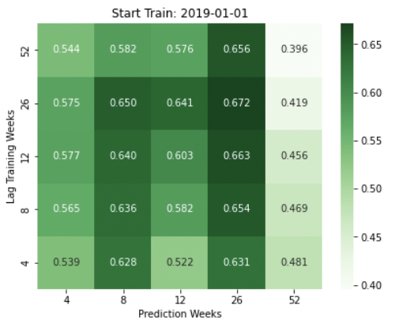
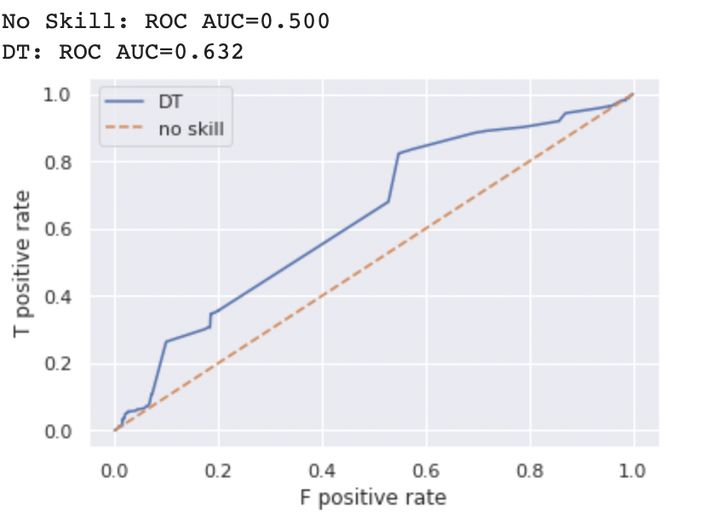
8. Result - Prediction Sensitivity
Temporal Hyperparameters {prediction weeks, lag training weeks, start train}

Slide 23
8. Result - Prediction Sensitivity
Model | Prediction Week | Lag | Start date
LR | 26 | 8 | 2017-01-01
DT | 26 | 26 | 2015-01-01
RF | 26 | 26 | 2015-01-01
XGBoost | 4 | 12 | 2015-01-01
CNN | 26 | 52 | 2015-01-01
LSTM | 26 | 52 | 2012-01-01

Slide 24
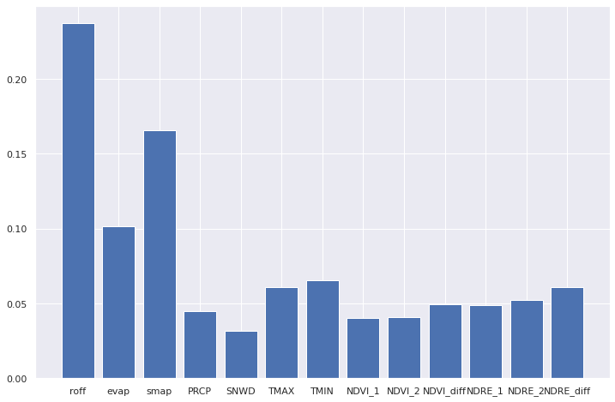
8. Result - Feature Importance
Model | Features Included
LR | Evaporation, runoff, soil moisture
DT | Soil moisture, precipitation, snow, temperature
RF | Evaporation, runoff, soil moisture, precipitation, snow, temperature
XGBoost | Evaporation, runoff, soil moisture, precipitation, snow, temperature
CNN | Evaporation, runoff, drought index (autoregressive self)
LSTM | Evaporation, runoff, drought index (autoregressive self)

Slide 25
8. Result - Regional Variability
Region | Prediction Week | Lag | Start date | Accuracy | AUC
Northeast | 8 | 26 | 2015-01-01 | 0.538 | 0.613
Upper Midwest | 8 | 26 | 2017-01-01 | 0.796 | 0.513
Ohio Valley | 8 | 4 | 2019-01-01 | 0.450 | 0.480
Southeast | 52 | 4 | 2015-01-01 | 0.475 | 0.521
Northern R & P | 12 | 8 | 2015-01-01 | 0.875 | 0.718
South | 12 | 4 | 2017-01-01 | 0.725 | 0.636
Southwest | - | - | - | - | -
Northwest | 4 | 26 | 2019-01-01 | 0.504 | 0.617
West | - | - | - | - | -
Notes:
c1 sentence of Impact statement +

Slide 26
8. Results - Takeaways
HIGH-LEVEL:
We find features that are related to drought occurrence
Machine learning model are useful in predicting mid-to-long term drought risk
Regional differences exist → need higher granularity in prediction
LIMITATION:
Data: sources? time of availability?
Model Choices: time series modeling?

Slide 27
THANK YOU!

